Slide 1









Do the Test Smells Assertion Roulette and Eager Test Impact Students’ Troubleshooting and Debugging?
International Conference on Software Engineering (ICSE)
Software Engineering Education and Training (SEET)
May 17th-May 20th, 2023
Here is where your presentation begins
Wajdi Aljedaani
Mohamed Wiem Mkaouer
Anthony Peruma
Stephanie Ludi
University of Hawaii
University of North Texas
Rochester Institute of Technology
University of North Texas
Notes:
Software Engineering Education and Training

Slide 2
Context
Software testing is an essential part of the software development life cycle.
Test code is also subject to bad programming practices by developers, known as test smells.
In 2001 [1], the catalog of test smells has been steadily growing throughout the years.
Ensure
Discovers
Guarantees
Reliable software
Defects/bugs
Quality of the software
[1] Arie Van Deursen, Leon Moonen, Alex Van Den Bergh, and Gerard Kok. 2001. Refactoring test code. In Proceedings of the 2nd international conference on extreme programming and flexible processes in software engineering (XP2001). 92–95.
02

Slide 3
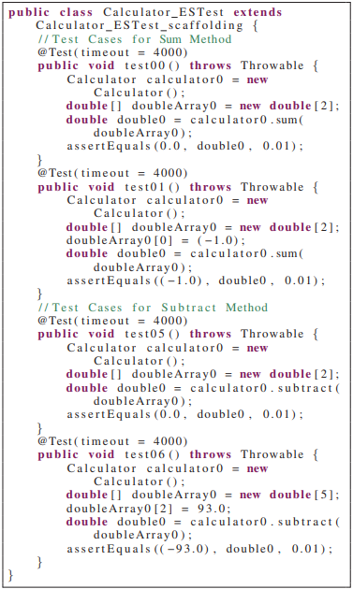
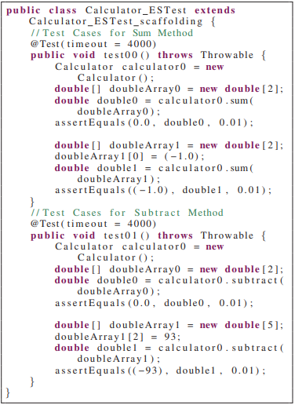
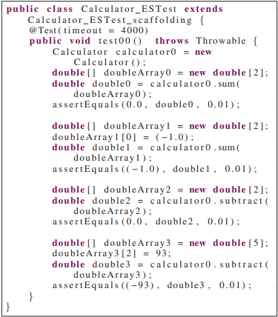
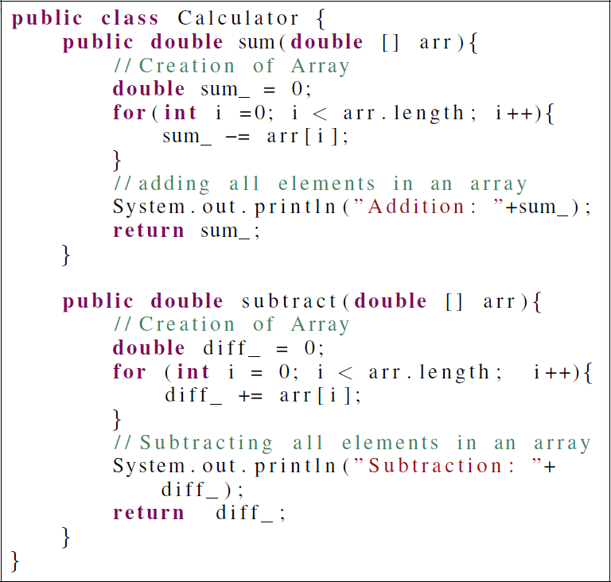
Problem Statment
Is it OK to write smelly test methods?
Listing 4: Example of test case source code for Eager Test suite.
Listing 2: Example of test case source code for Non-test Smell test suite.
Listing 3: Example of test case source code for Assertion Roulette test suite.
03
Notes:
This is a given code, to test a given code, student may write multiple tests that test piece of code.
One student write this test cases that does not contain test smell.
Other student can write test cases which contain the Assertion Rolette smell. Which this case someone making multiple asserts under the same test case.
Another student also write test cases that multiple methods under the same test cases. All of these test cases are equivalent because they all are producing the same type of test outcomes.
However, students exist test smell and some does not.

Slide 4
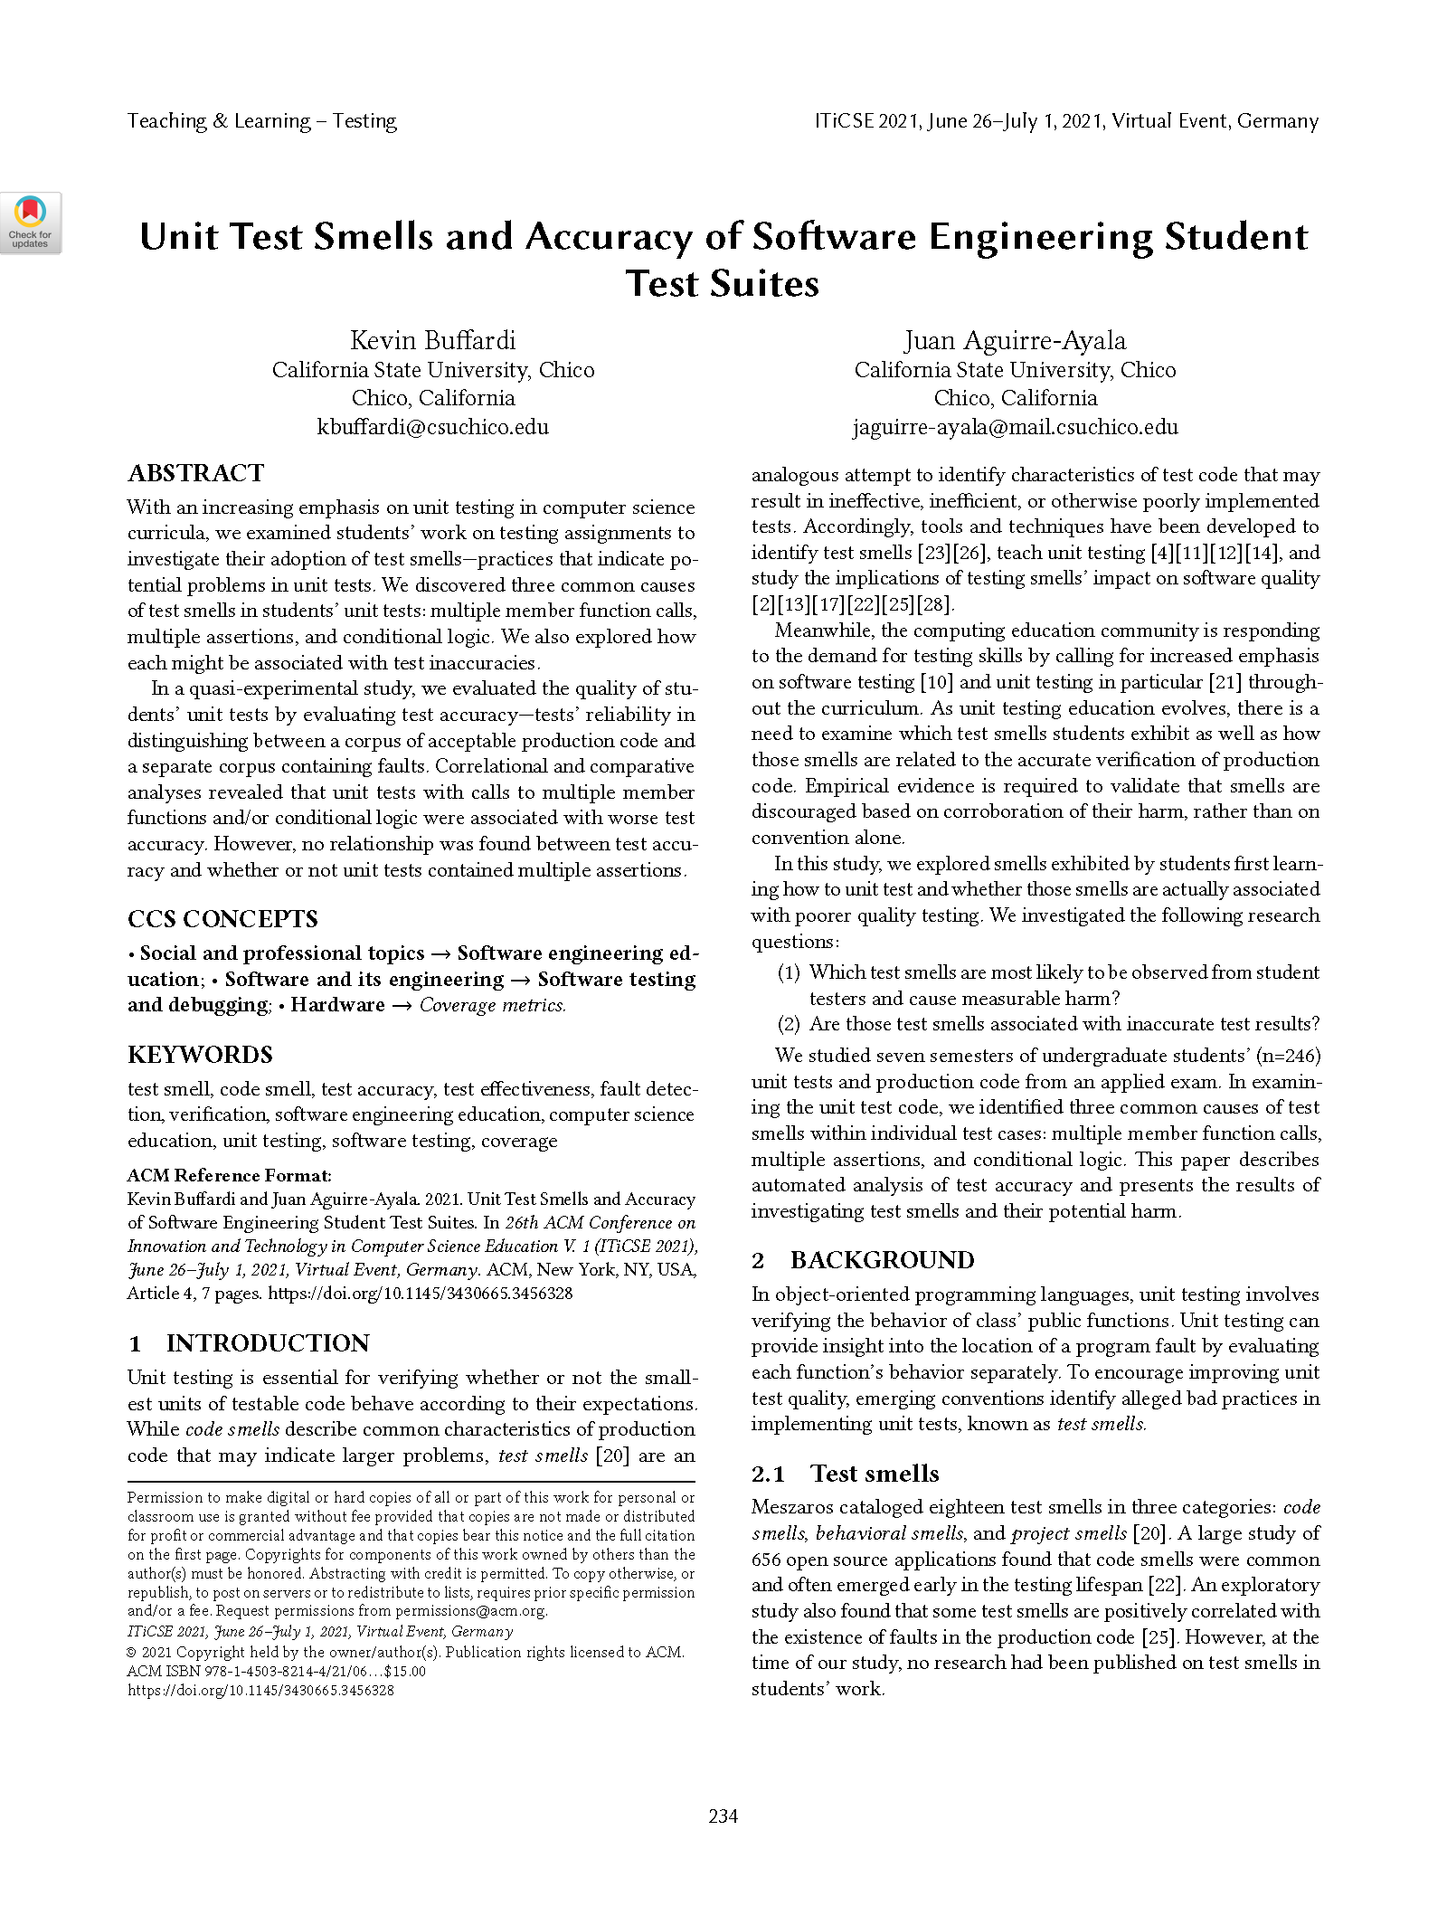
Problem Statment
Exploring smells exhibited by students first learning how to unit test
04
Notes:
Previous studies argue differently through this. Multiple researchers have different opinion about this.
1- First, the study said that it is not okay to write smelly test cases.
2- Other study said Assertion Roulette tests should not be code smell because it is good code.
Obviously, we have different opinion here. Therefore,

Slide 5
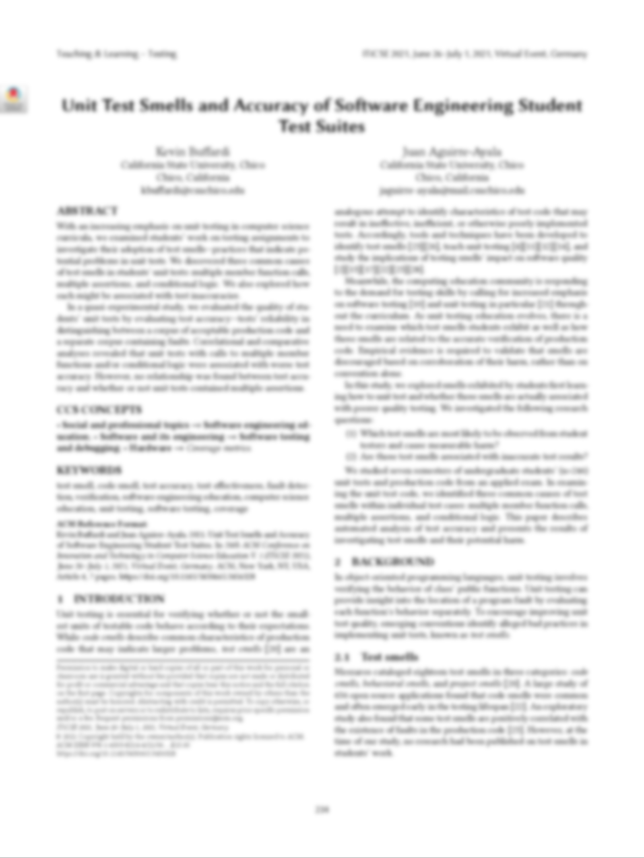
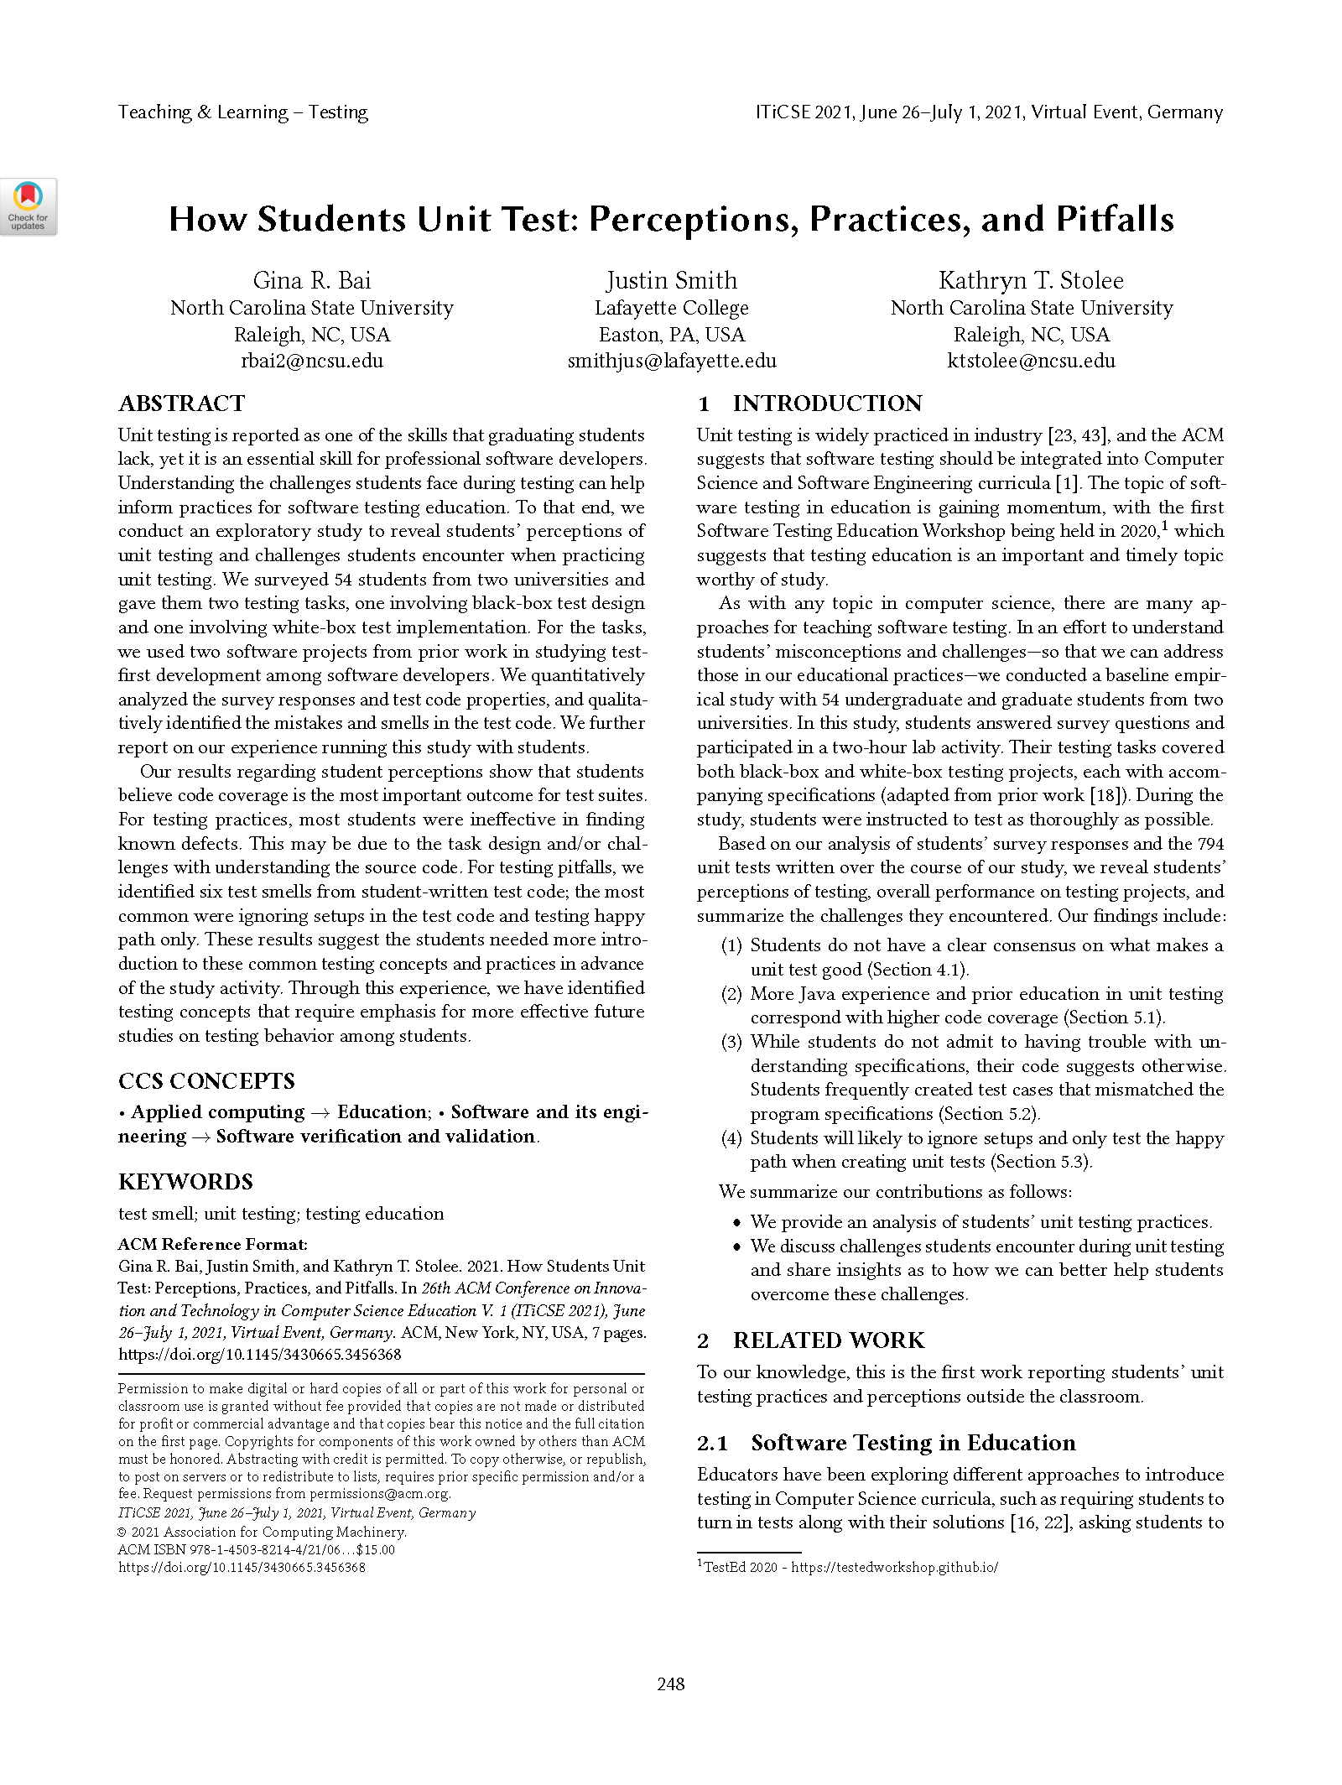
Problem Statment
Exploring smells exhibited by students first learning how to unit test
Discovering students’ perceptions & challenges when practicing unit testing
04

Slide 6
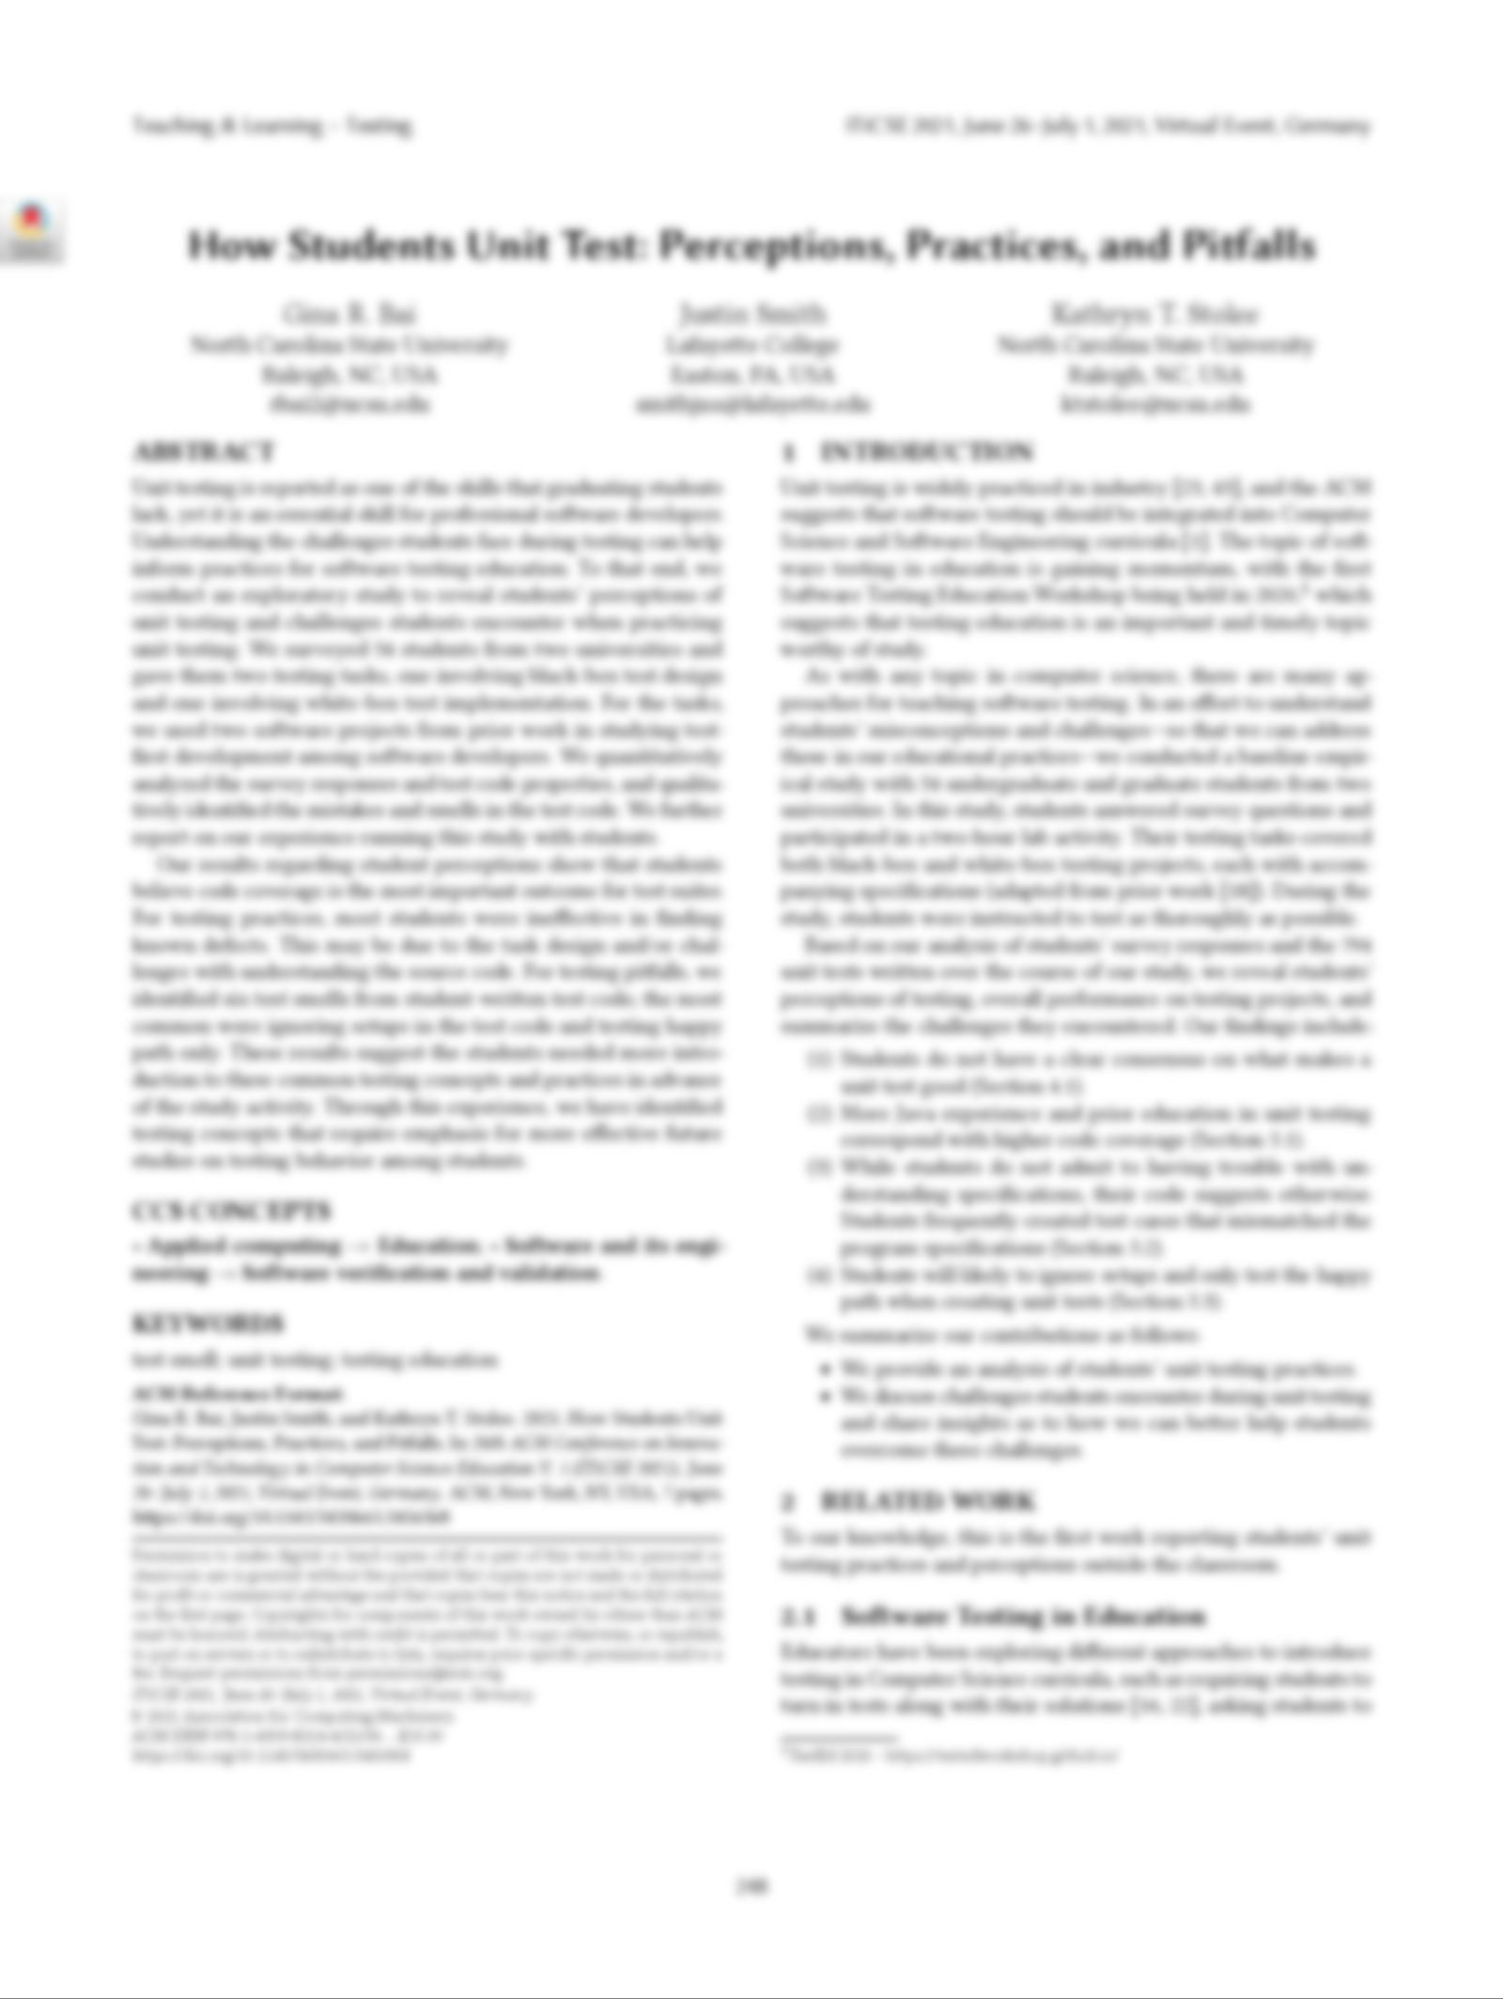
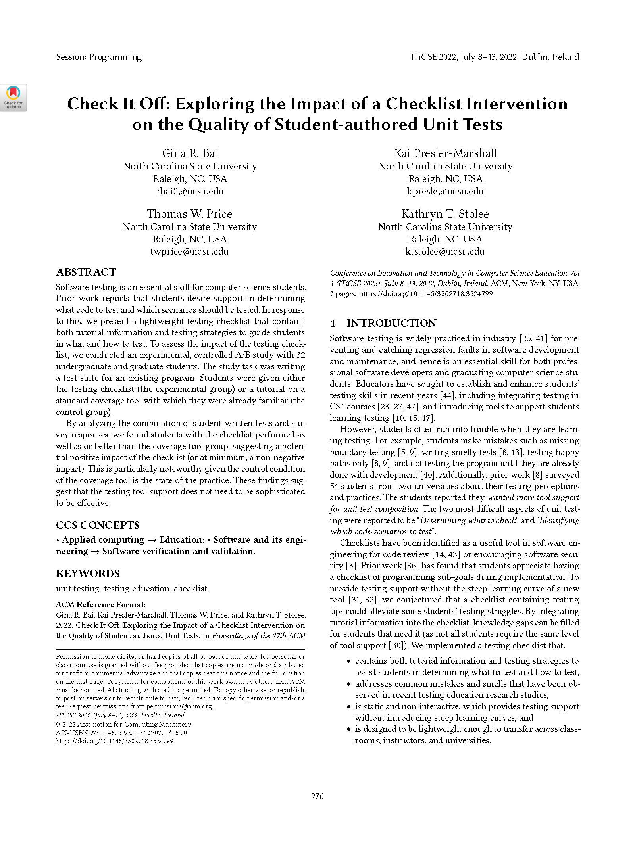
Problem Statment
Exploring smells exhibited by students first learning how to unit test
Discovering students’ perceptions & challenges when practicing unit testing
Assessing the impact of the testing checklist
04

Slide 7
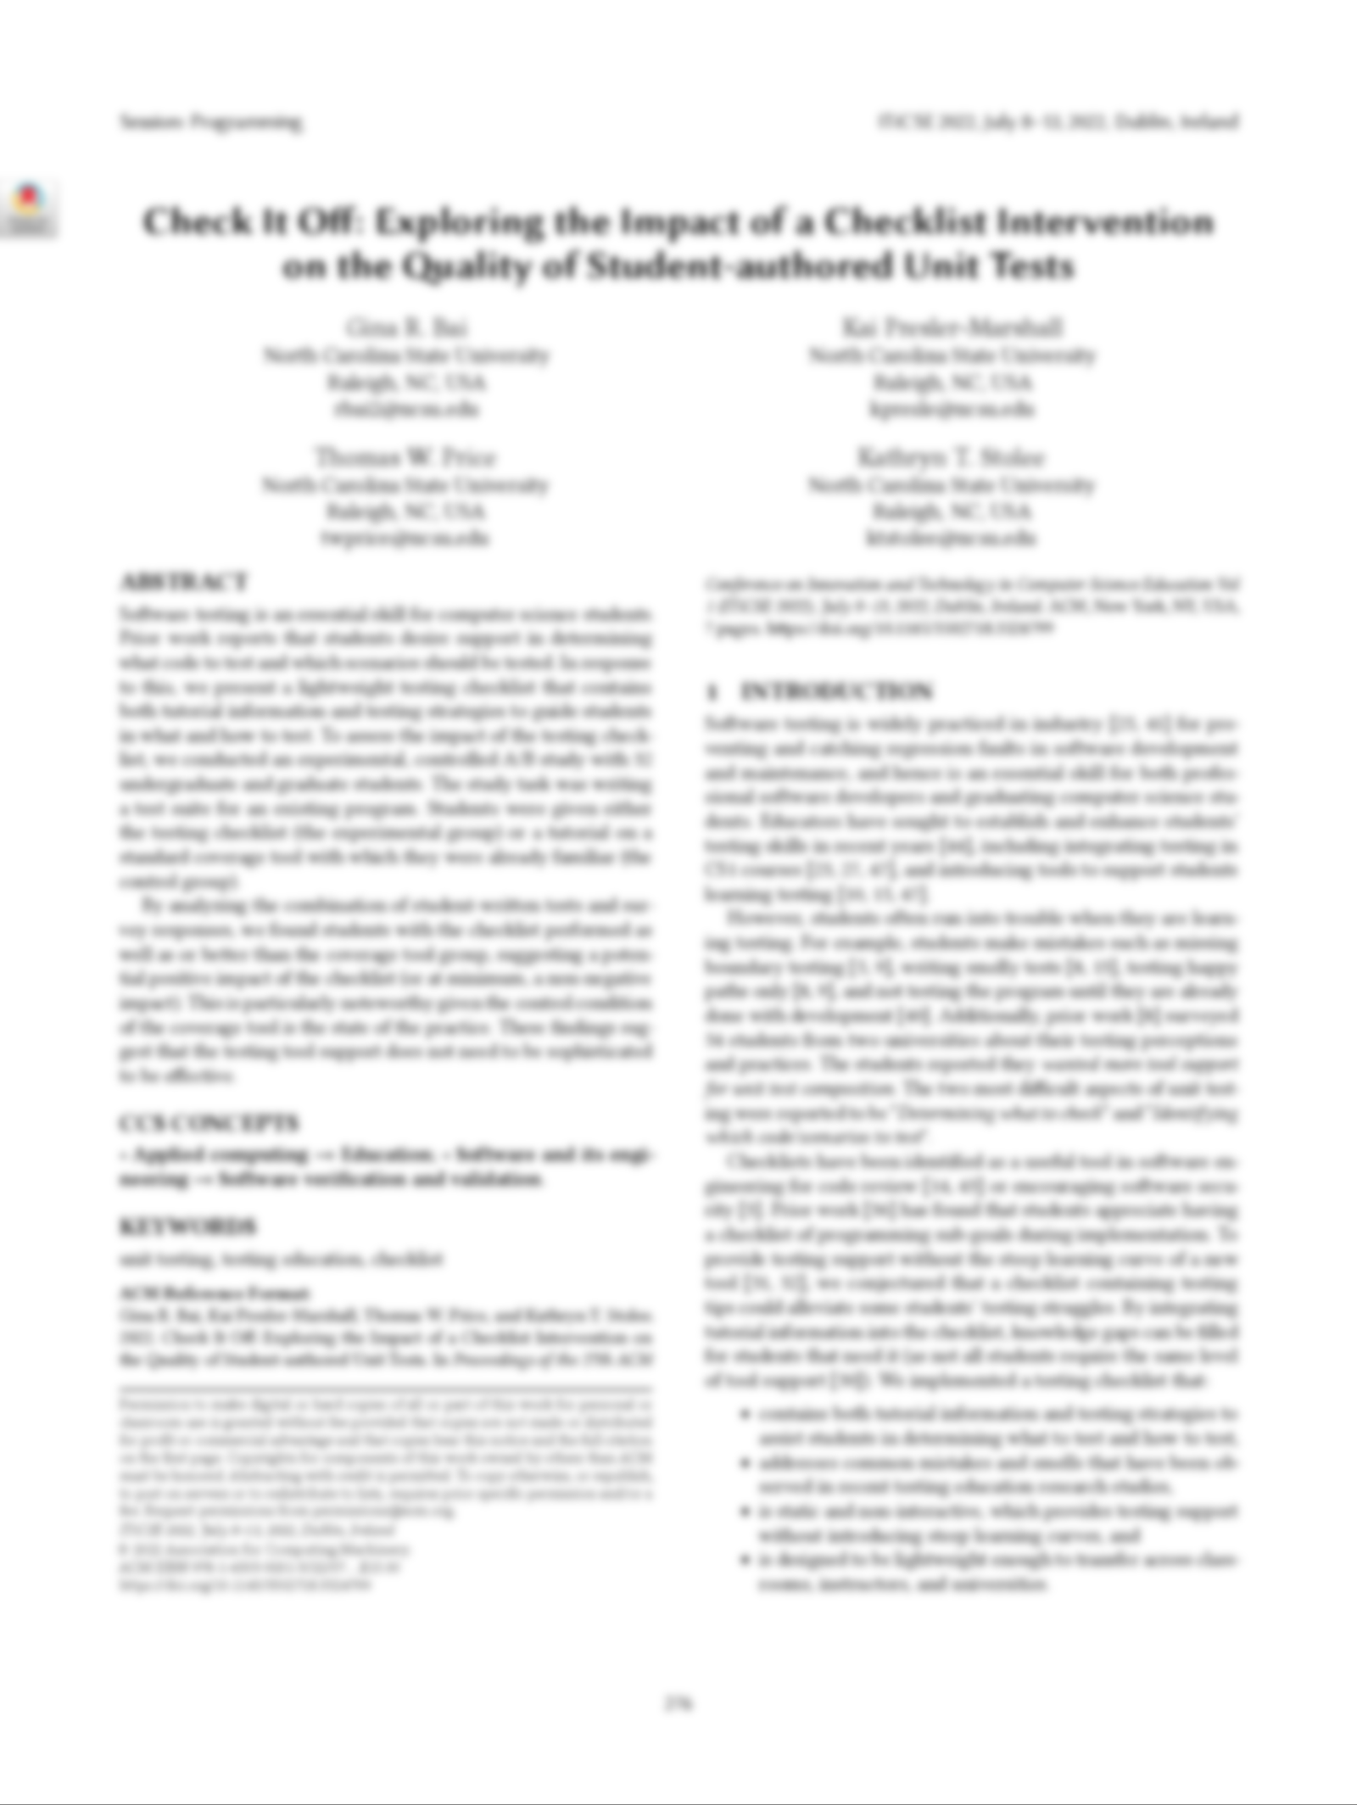
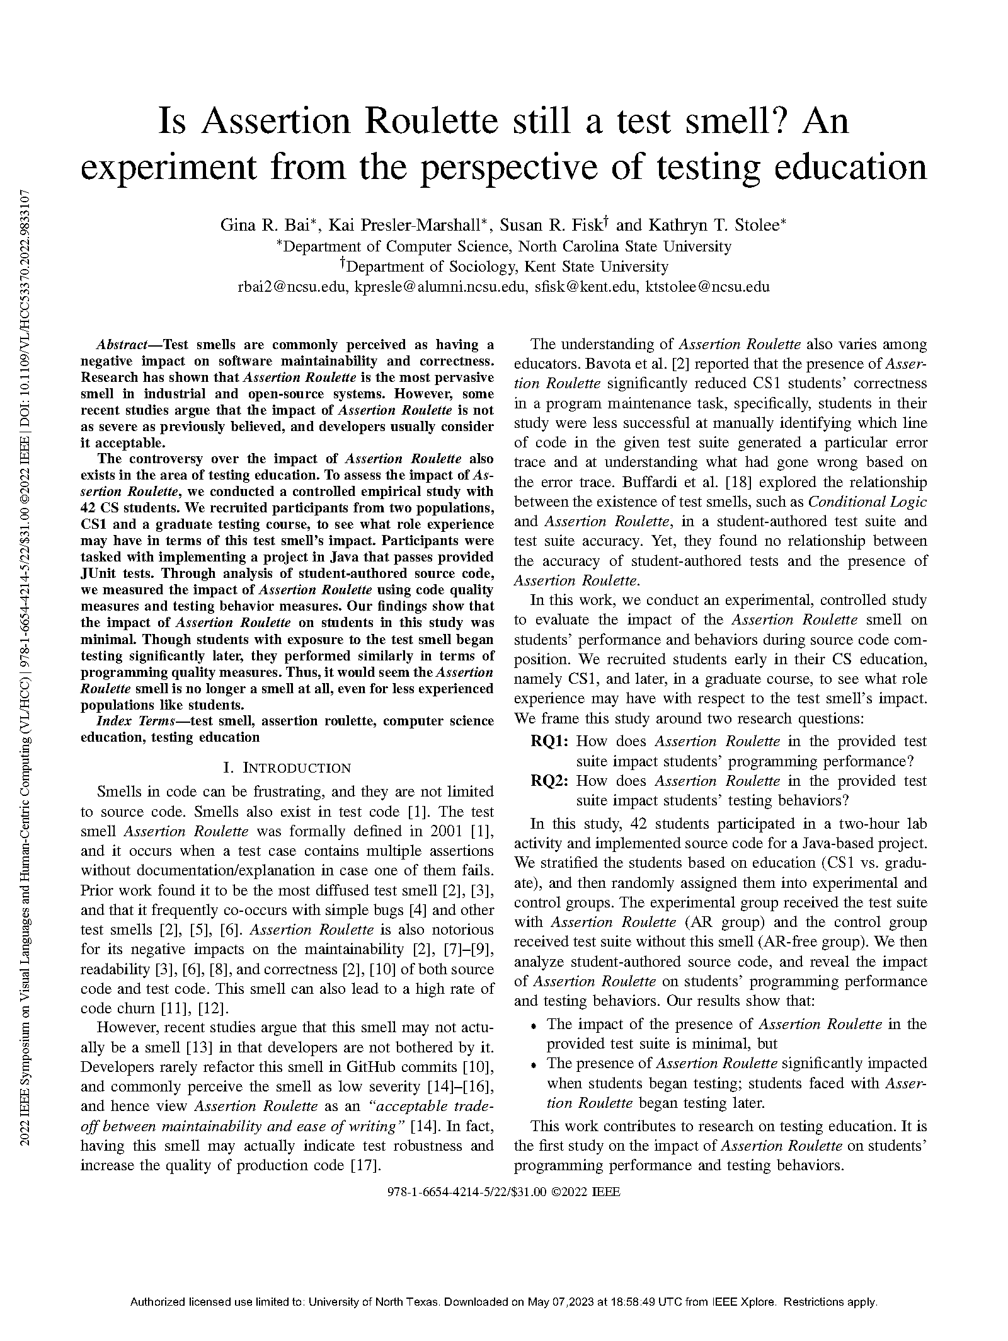
Problem Statment
Exploring smells exhibited by students first learning how to unit test
Discovering students’ perceptions & challenges when practicing unit testing
Assessing the impact of the testing checklist
Evaluate the impact of the Assertion Roulette smell on students’ performance & behaviors during source code composition.
04

Slide 8
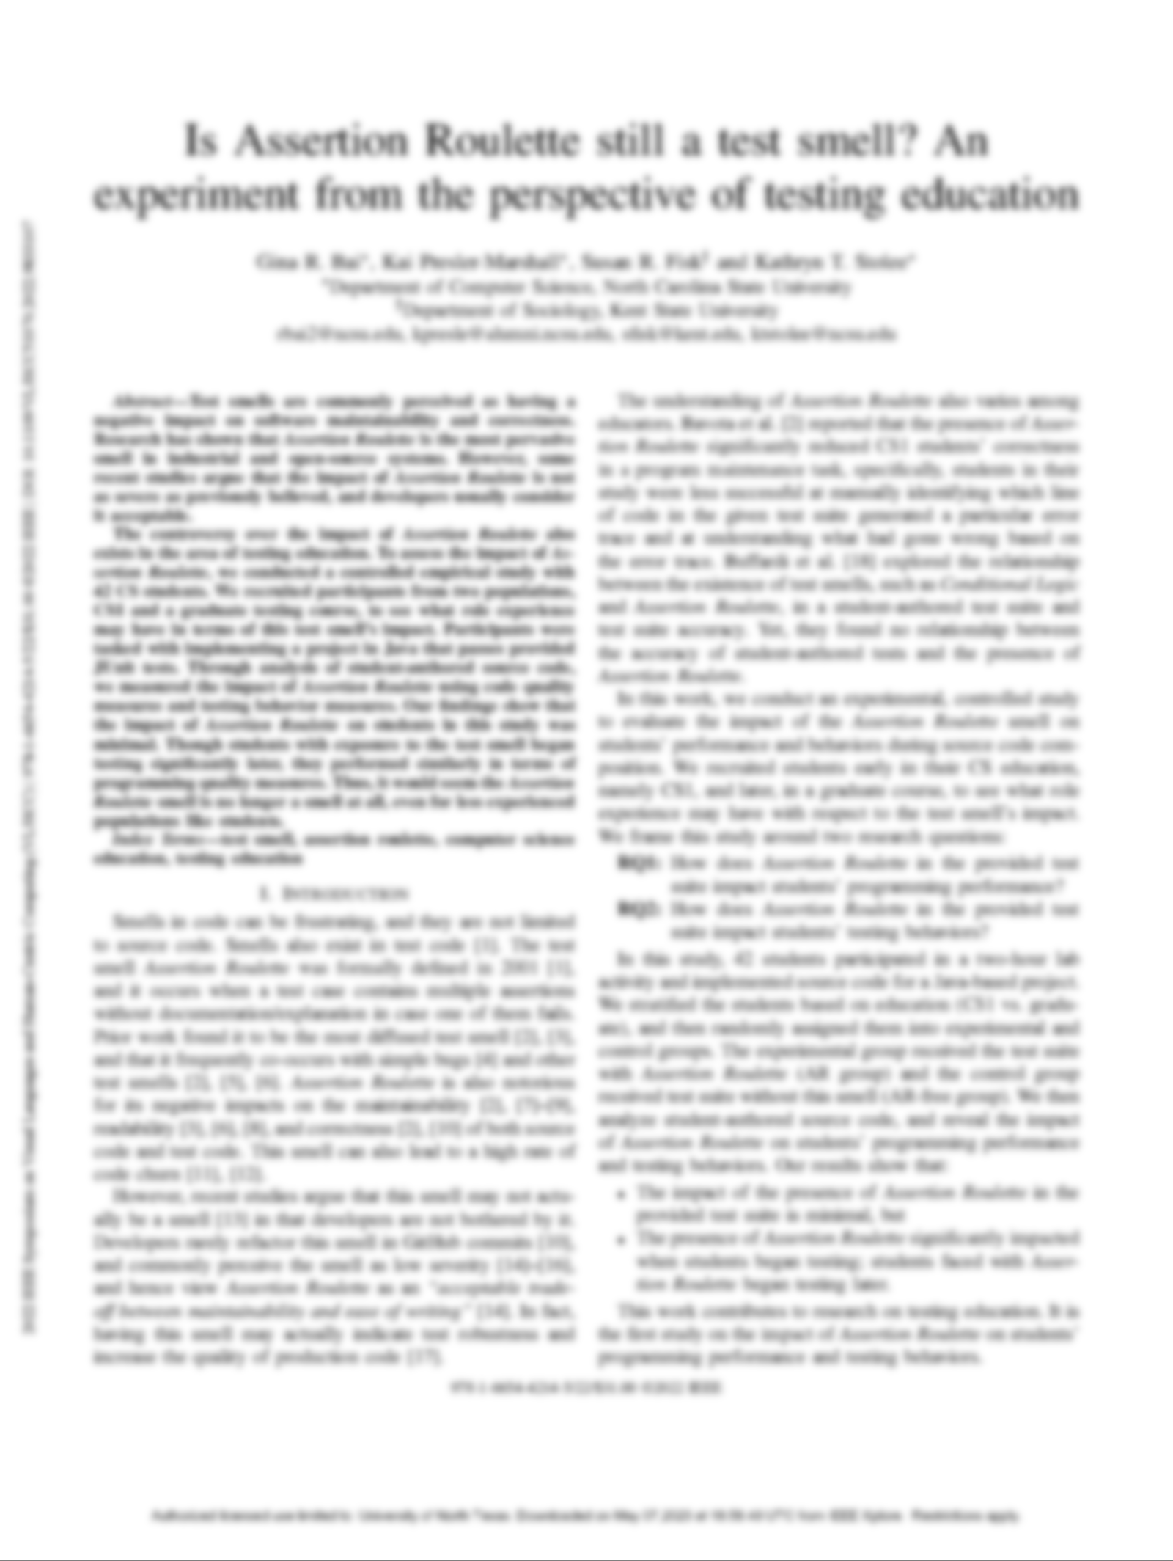
Problem Statment
Our goal is to determine whether Assertion Roulette and Eager Test negatively impact student’s troubleshooting and debugging.
Exploring smells exhibited by students first learning how to unit test
Discovering students’ perceptions & challenges when practicing unit testing
Assessing the impact of the testing checklist
Evaluate the impact of the Assertion Roulette smell on students’ performance & behaviors during source code composition.
Compare the effect of smelly and non-smelly test suites on students debugging performance.
04
Notes:
compares the effect that smelly and non-smelly test suites have on students when tasked with fixing failing test cases by only correcting defects in the production code of a system they are familiar with

Slide 9
Researach Question
To what extent do Assertion Roulette and Eager Test impact the time spent by students in debugging failing test cases?
RQ
05

Slide 10
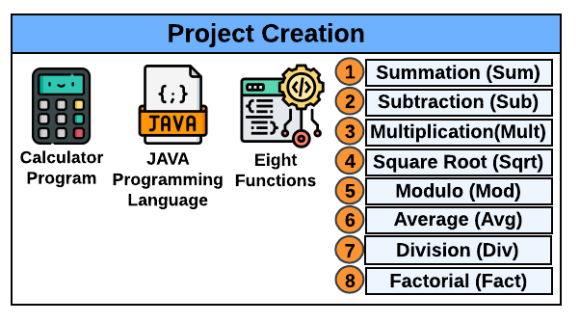
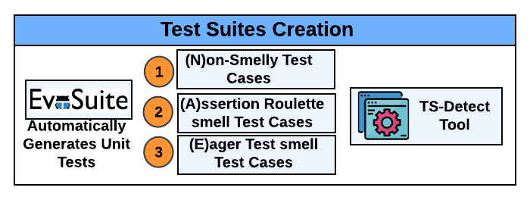
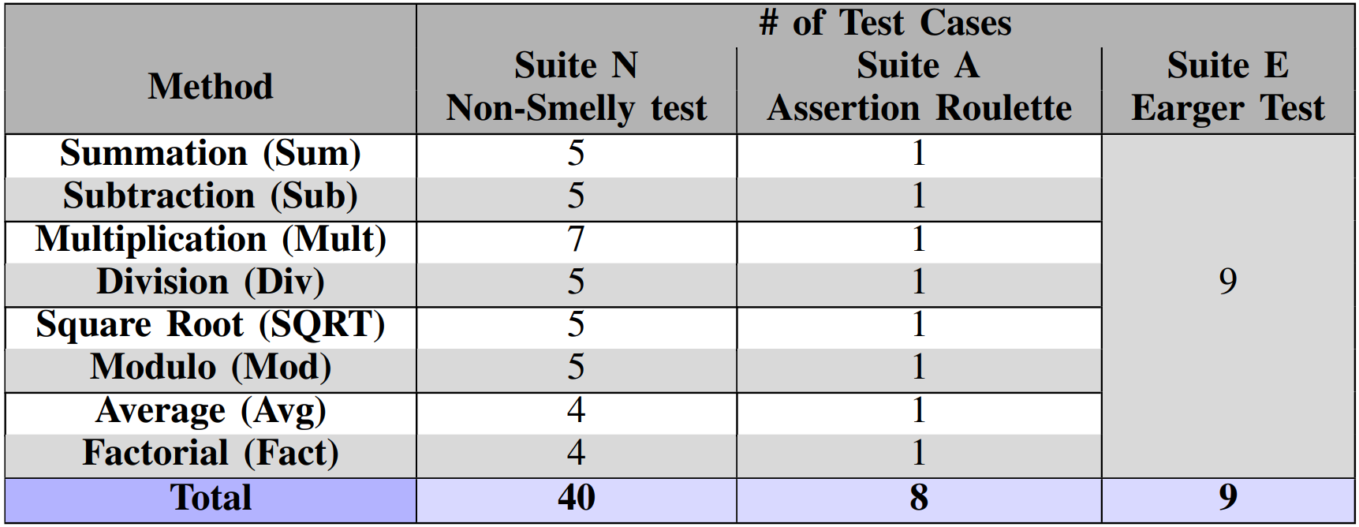
Study Approach
06

Slide 11
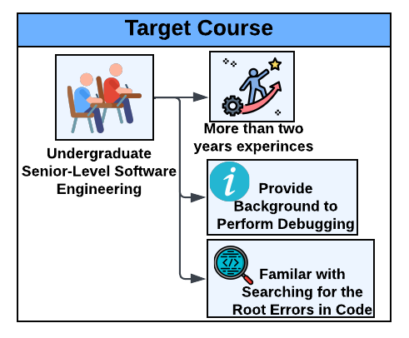
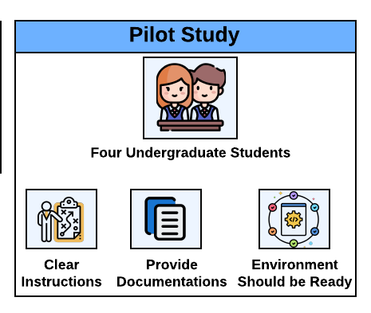
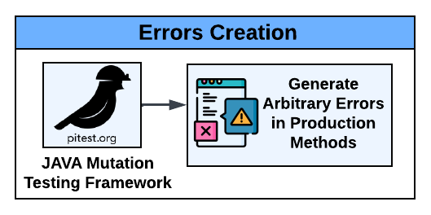
Study Approach
07

Slide 12
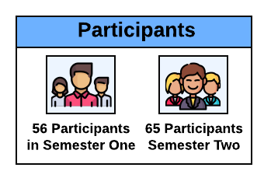
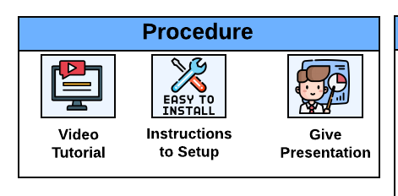
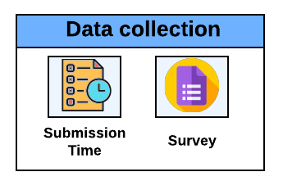
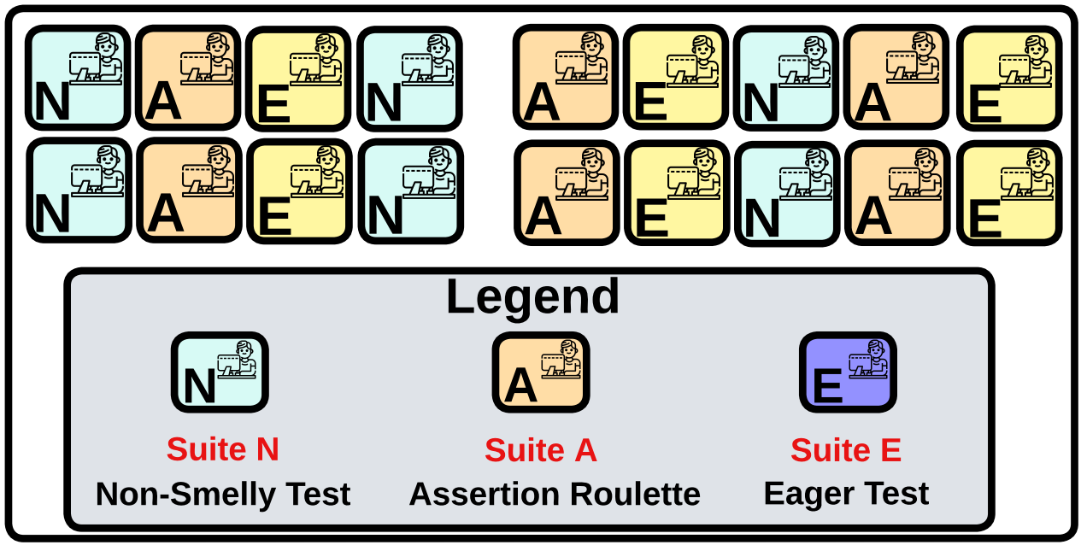
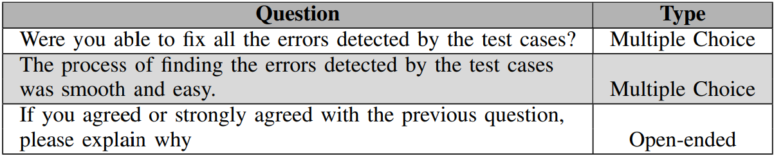
Study Approach
08

Slide 13
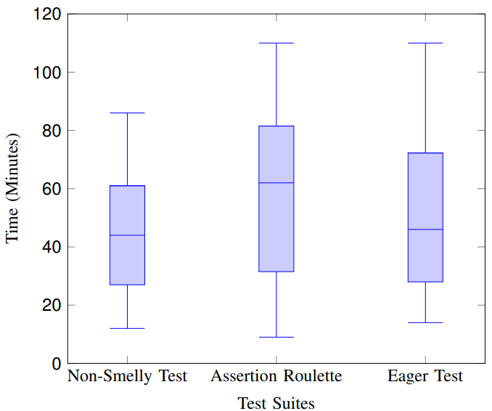
Study Results
01
Experiment Results
Group (A) values are significantly higher than the values of group N (i.e., p< 0.05). Similarly, group (E) values are significantly higher than the values of group (N) (i.e., p< 0.05).
Smelly Tests are negatively impacting the students’ debugging process.
Fig: Distribution of the time spent by participants
to detect and debug each test suite.
09
Notes:
Summary: The presence of test smells, namely Assertion Roulette and Eager Test, in the test suite cause participants to spend more time troubleshooting test case failures, in comparison with performing the same debugging process using a non-smelly suite.

Slide 14
Study Results
01
Experiment Results
Bai et al. [2] demonstrated, through a controlled classroom experiment, that Assertion Roulette does not impact neither the frequency of testing nor the accuracy of the test cases.
Our observation contradicts the findings of Bai et al. [2], who conjecture that Assertion Roulette may no longer be considered a code smell.
Such situations result in participants reviewing multiple production methods and continually switching between multiple code files as part of their troubleshooting task, which potentially increases their cognitive load and debugging time.
10
[2] G. R. Bai, K. Presler-Marshall, S. R. Fisk, and K. T. Stolee. Is assertion roulette still a test smell? an experiment from the perspective of testing education. In 2022 IEEE Symposium on Visual Languages and HumanCentric Computing (VL/HCC), pages 1–7. IEEE, 2022.
Notes:
Such situations result in participants reviewing multiple production methods and continually switching between multiple code files as part of their troubleshooting task, which potentially increases their cognitive load and debugging time.

Slide 15

Study Results
02
Survey Results
Were you able to fix all the errors detected by the test cases?
Survey Q1
We found that a total of 13 participants were unable to locate and fix the source code.
3
Participants in Non-Smelly Test
Participants assigned with the Assertion Roulette test suite had the highest percentage that was unable to complete the assignment within the given time frame revealing the negative impact of this particular smell.
We found that a total of 13 participants were unable to locate and fix the source code
3 Participants in Non-Smelly Test
3 Participants in Eager Test
7 Participants in Assertion Roulette test
3
Participants in Eager Test
7
Participants in Assertion Roulette test
11
Notes:
Although the participants were unaware of the test smells they were assigned, most of them managed to locate and fix all the issues in the source code. Additionally, participants assigned with the Assertion Roulette test suite had the highest percentage that was unable to complete the assignment within the given time frame revealing the negative impact of this particular smell.

Slide 16
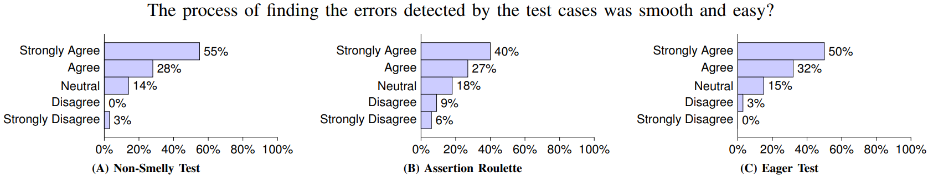
Study Results
02
Survey Results
Fig: Distribution of students’ responses to survey question #2.
Students did not notice any difference between smelly and non smelly test methods.
12
Notes:
(A) the absence of test smells in the test cases makes the participants’ task of debugging easy to understand and simple to fix.
(B) due to the test cases’ inclusion of numerous untitled assertions, which confused the participants. The participants spent more time locating the assertion that caused the test case to fail, making it more difficult to handle. Therefore, the most difficult test smell to address in the test cases can be ruled out as Assertion Roulette.
( C) Moreover, this smell induces multiple production codes when one method is invoked, causing a significant impact on the debugging skills of the participants. However, participants found it comparatively easy to handle as they were able to follow up on the logic of the operation and locate the bug in the source code.

Slide 17



Study Takeaways
Teaching students about design and code smells
Producing tools to aid developers with detecting correcting test smells
Exploring the types of test smells are unique to specific programming languages.
Writing quality test cases. Code reviews should not be limited to the production code.
Various programming languages and testing frameworks.
Research and academic community should invest in exploring the types of test smells. Test smells are not unique to JUnit based test suites.
13
Notes:
Educators need to raise the students’ awareness of writing smell-free test cases. Students need to be taught how to avoid writing multiple asserts under the same test methods, or to test multiple production methods, using the same test method.

Slide 18


Threats to Validity
Participants
Selection of Test Smell
Two Semesters
Calculator Application
Reviewed various research papers
Most popular
and frequent smells
14
Notes:
Another pertinent threat relates to the choice of the project under test. The complexity of the project features may require advanced debugging skills, which may crate a significant overhead in our experiment.

Slide 19
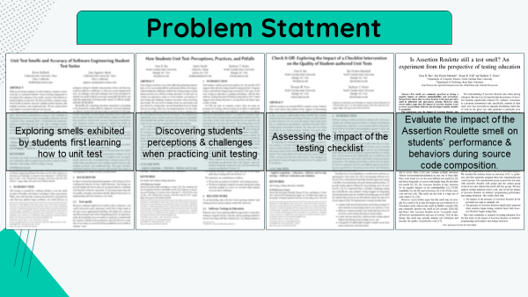
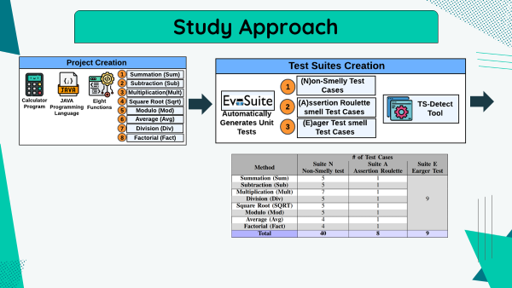
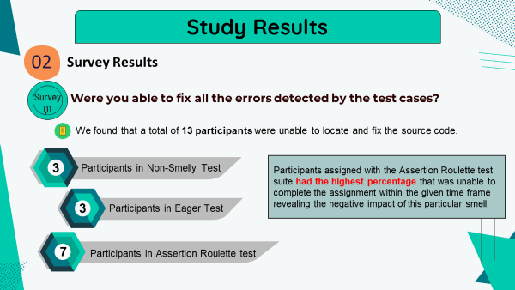
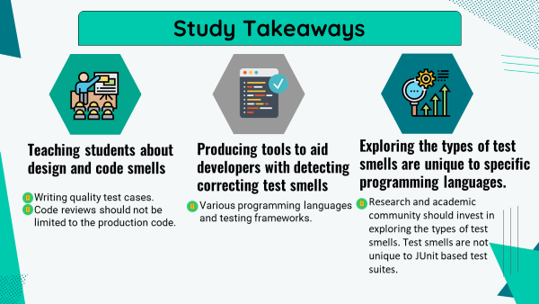
Conclusion
15

Slide 20
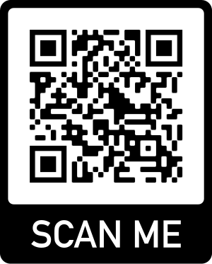



Thank you for listening!
Do you have any questions?
@Wajdialjedaani
Wajdi.j1@gmail.com
Replicated Package
Wajdi Aljedaani

